Slide 1

DriverPass System Analysis
Ariana Hernandez
Notes:
[No speaker notes required for this slide.]

Slide 2

System Requirements
Functional Requirements
Connection to the DMV database to keep up to date with the rules
The system must keep track of all appointments and provide activity reports
Non – Functional Requirements
Case-sensitive Usernames and passwords
Resetting a forgotten password
Notes:
[In your speaker notes, include an explanation of the different requirements you determined for DriverPass’s system. What are the functional requirements you selected to describe? What are the nonfunctional requirements you selected to describe? Be sure to explain how these requirements meet DriverPass’s needs.
The function requirements were chose because there are some necessary function that is needed for DriverPass to be proper. The system must be connected to the DMV database because there needs to be a legitimate and legal base for the online courses to follow to properly teach Users. They system must be able to keep track of all appointments made to ensure that students are getting matched with the driver they had connected to.
Non-functional requirements that are needed for the system is the case-sensitive Username and Password. This is essential to the system because this is where the whole process begins, with the User logging in. Being able to ensure that there is security with a customer’s username and password is needed for the system. Along those lines, ensuring a sense of security, the system should allow for a User to reset a password if they have forgotten theirs. Allowing for Users to reset their password after properly identifying the User through other means such as an Email, will be necessary for the project ]

Slide 3
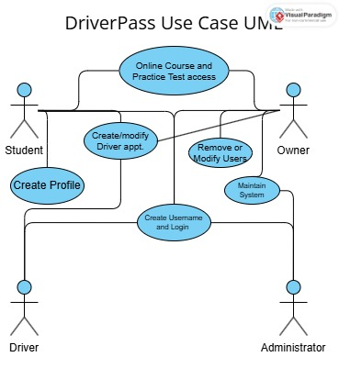
Use Case Diagram
Notes:
[Explain your diagram. Who are the different actors in the system? What are the different use cases? How did you account for DriverPass’s needs in your design? In your explanation, keep your audience in mind. Avoid the use of terms like “actors” and “use cases” in your explanation
There are 4 different actors in the diagram displayed above. The owner, the student, the administrators (or IT department), and the drivers. The points of the project that are necessary are the creating a Username and Password to login, which everyone within this project will have to do. The owner has access to every point of the diagram which is why he has so many line. However, the student has many access such as making or modifying appointments with driver; the drivers also have this ability. Students also can create a profile with their information and the course content. Another point forgotten in this chart is the ability in changing the User Passwords. The administrators maintain the system and make sure that the webpage is working properly. ]

Slide 4
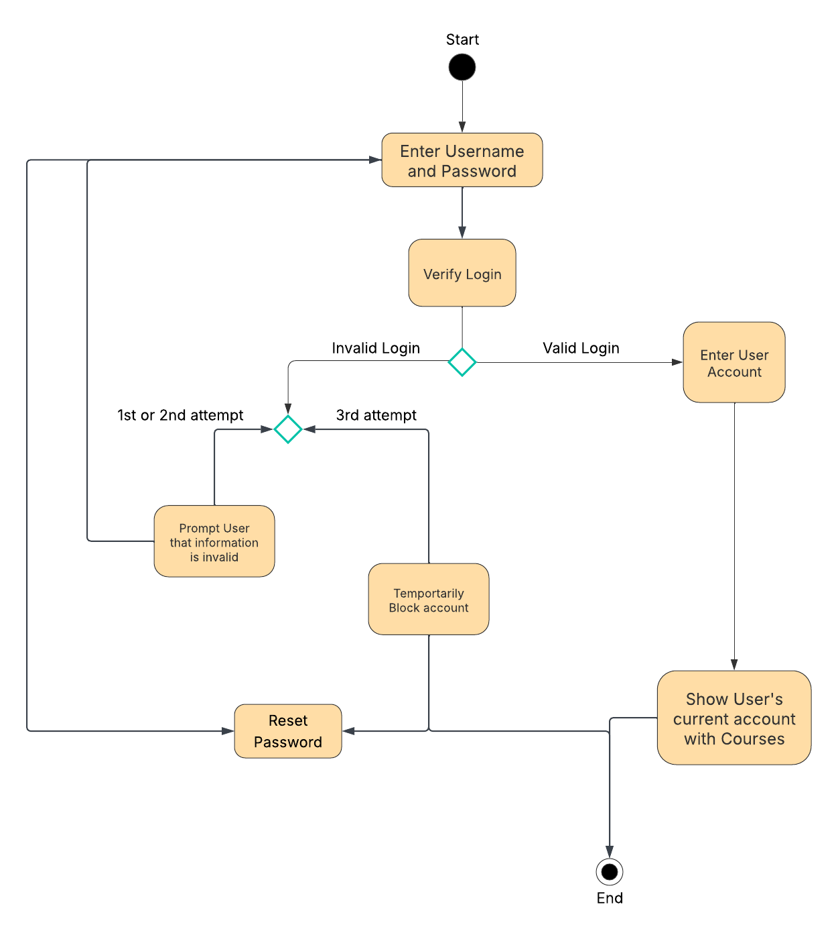
Activity Diagram
Notes:
[Explain your diagram. Which use case are you breaking down? What are the steps for this use case? How did you account for DriverPass’s needs in your design? In your explanation, keep your audience in mind. Avoid the use of technical terms such as “nodes,” “control flows,” and so on.
I broke down the process of logging in from a Customer’s standpoint. I started with inputting a Username and Password which then leads to verifying that the combination is correct. The Username a Password are case-sensitive so there is a chance to retry the login just in case there was a minor spelling error. However, with the third incorrect attempt the account will be locked. From then the account will only accessible if the User changes their password. Then that will reroute them to entering the Username and Password combination again. If there is no incorrect attempts, the process will enter the webpage and then access the specific User’s account with all their profile information. ]

Slide 5
Security
Starts with the User logging in with their Username and Passwor
Password resestting is available to ussers if they forget
Owner will have full access to account which includes being able to reset passwords or block access
After too many failed attempts at logging in, a temporary account block will take place
The server will be protected by the cloud
Notes:
[How did you consider security in your design? In your explanation, keep your audience in mind by avoiding the use of technical terms.
Security is always the best investment when you are a new business wanting consumers to trust you. Providing the Users a chance to make their own login and password creates a level of trust. Allowing for a password change to be possible if a password is forgotten also allows for a customer to be secure and protected from being unable to enter their account. Having a temporary block allows for Users to see that login information is important to the server and it also signals the server to be wary of a certain accounts for extra security. ]

Slide 6
System Limitations
There is a short timeline to develop the project
Connection to the DMV database
No on-staff developer to keep up with the upkeep of the website
Cloud protection is
Notes:
[What are the limitations of your design? In your explanation, keep your audience in mind by avoiding the use of technical terms.
With all projects, there comes some form of limitation. First is the timeline we are given. 5 months is a large window frame however when it comes to building something as complex and large as this website, time is a valuable resource to have to ensure that the website meets any and all expectations. Another limitation, there is no on-staff develop that could make any changes or maintenance to the website once we sign-off in May, this is a set back for the client. The constant connection to the DMV may be tricky since there is a plausible chance that being connected to multiple DMVs may be necessary. As seen in almost all project, budget is another large limitation. The protection of the server will be based on the cloud being used and that is a huge price to put into consideration to protect the Users and Admin’s private info.]

